Slide 1
South Ladder In-Ladder Install Variant

Slide 2
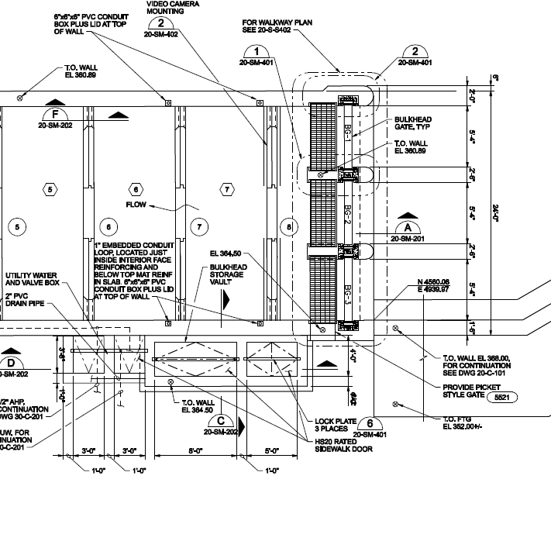
Position of Vaki RW in Pool 8
Funnel attached to Weir 8 notch; Vaki RW attached to funnel
Funnel
Vaki RW

Slide 3
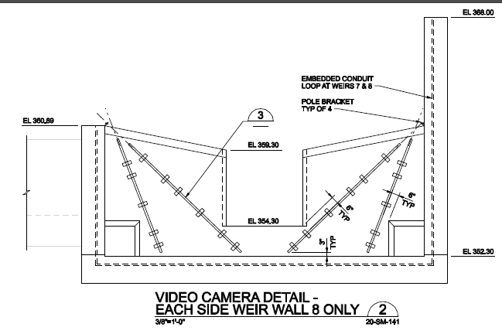
Vaki RW Counter in Red w/ dimension callouts in red as well (20’’ x 15’’);
Sketch not to scale
5’
15’’
20’’’
5’

